Slide 1

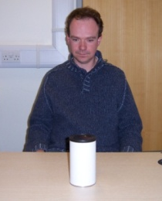



Limits on “efficient” mindreading?
Infant system develops
Language, Executive function, Knowledge
Automatisation
Cognitive efficiency does not come for free
Infant system preserved
Language, Executive function, Knowledge

